Slide 1

BU8201 TUTORIAL 7 COST OF CAPITAL
Group 2
Tania Salih
Brian
Hui Ting
Benjamin

Slide 2
REVIEW
Sources of Capital
Long-term Capital
Long-term Debt
Preferred Stock
Common Stock
Retained Earnings
New Common Stock

Slide 3

REVIEW
Weighted Average Cost of Capital:
w: firm’s capital structure weights
r: cost of each component
WACC = (% of Debt)(After-Tax Cost of Debt)
+ (% of Preferred Stock)(Cost of Preferred Stock)
+ (% of Common Equity)(Cost of Common Equity)

Slide 4

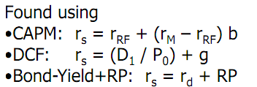
REVIEW
Weighted Average Cost of Capital:
Found using interest rate determinant :
r _{d} = r* + IP + MRP + DRP + LP
(Equivalent to YTM)

Slide 5
REVIEW
Flotation Cost
When a company issues new common stock they also have to pay flotation costs to the underwriter.
r_{e} > r_{s}
D₀ (1 + g)
r_{e} =
+ g
P₀ (1- F)

Slide 6
REVIEW
Hurdle Rate
Projects should be accepted if estimated returns exceed their cost of capital.
( expected return > WACC ) YES
( expected return < WACC ) NO
WACC only represents the “hurdle rate” for a typical project with average risk. (Return of project > hurdle rate before acceptance)

Slide 7
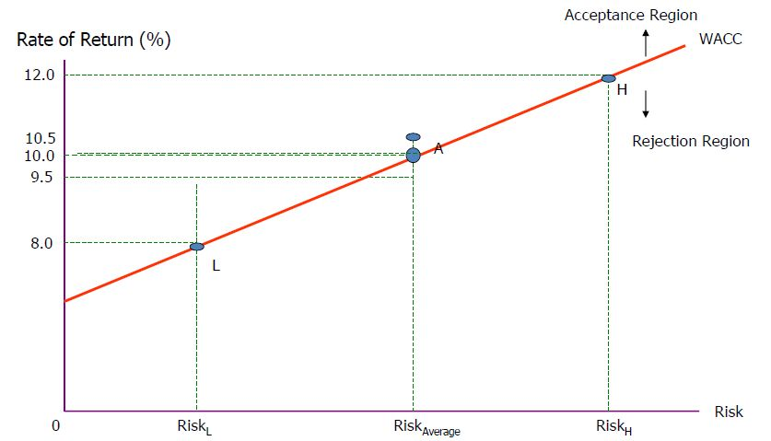
REVIEW
Adjusting WACC for Risk
Factoring risk, project A’s hurdle rate(WACC) is 10%. Both firms will accept.

Slide 8
Q11-2
Assume that the risk free rates increases.
What Impact would this have on the cost of debt?
r _{d} = r* + IP + MRP + DRP + LP
r* + IP = Risk-free rate of interest, is the rate on a riskless security in a world without inflation.
If the risk free rate increases and the rest of the premiums remain constant, it would affect the cost of debt of a company. In other words, by increasing the risk-free rate it would increase the cost of a company to borrow funds.

Slide 9
b) What impact would it have on the cost of equity?
CAPM r_{s} = r_{RF} + (r_{M} - r_{RF}) b
The cost of equity (r_{s}) will increase, decrease or remain the same depending on the beta (b) and the risk of market (r_{M}).
Own-Bond-Yield-Plus- Risk Premium r_{s} = r_{d} + RP
From part (a), r_{d} increases from the increase in r_{RF}. Thus r_{s} will increase also.

Slide 10
Q11-3
Cost of common equity. Percy Motors has a target capital structure of 40 percent debt and 60 percent common equity, with no preferred stock. The yield to maturity on the company’s outstanding bonds is 9 percent, and its tax rate is 40 percent. Percy’s CFO estimates that the company’s WACC is 9.96 percent. What is Percy’s cost of common equity?

Slide 11
Given:
WACC = 0.096
w_{d} = 0.4
w_{c} = 0.60
r_{d} = 0.09
T = 0.40
w_{p} r_{p} = 0 (No preferred stock)
WACC = w_{d} r_{d} (1-T) + w_{p} r_{p} + w_{c} r_{s}
(0.0996) = (0.4)(0.09)(1 - 0.40) + 0 + (0.60)r_{s}
r_{s} = 0.13 = 13%

Slide 12
Q11-6
Cost of common equity. The future earnings, dividends and common stock price of Carpetto Technologies Inc. are expected to grow at 7 percent per year. Carpetto’s common stock sells for $23 per share, its last dividend was $2.00, and it will pay a dividend of $2.14 at the end of the current year.

Slide 13
Using the DCF approach, what is its cost of common equity?
Given:
D₁= $2.14
P_{o} = $23.00
g = 7%
r_{s} = (D₁/P₀) + g
= (2.14/23) + 0.07
= 0.163 = 16.3%

Slide 14
(b) If the firm’s beta is 1.6, the risk-free rate is 9 percent, and the average return on the market is 13 percent, what will be the firm’s cost of common equity using the CAPM approach?
Given:
b = 1.6
r_{RF} = 9%
r_{M} = 13%
r_{s} = r_{RF} + (r_{M} - r_{RF}) b
r_{s} = (0.09) + (0.13 - 0.09)(1.6)
= 0.154 = 15.4%

Slide 15
(c) If the firm’s bonds earn a return of 12 percent, based on the bond-yield-plus-risk-premium approach, what will be r_{s}? Use the midpoint of the risk premium range discussed in Section 11-15 in your calculations.
Given:
r_{d} = 0.12
RP = 0.04 (general range is 3% - 5%, midpoint is 4% -Lect 7,P21 )
r_{s} = r_{d} + RP
r_{s} = (0.12) + (0.04)
r_{s} = 0.160 = 16%

Slide 16
(d) Assuming you have equal confidence in the inputs used for the three approaches, what is your estimate of Carpetto’s cost of common equity?
r_{s} = CAPM + DCF + ( r _{d} + RP) / 3
r_{s} = (16.3 + 15.4 + 16.0) / 3
r_{s} = 15.9%

Slide 17
Q11-11
WACC and percentage of debt financing
Hook Industries’ capital structure consists solely of debt and common equity. It can issue debt at r_{d} = 11% and its common stock currently pays a $2 dividend per share (D₀ = $2). The stock’s price is currently at $24.75; its dividend is expected to grow at a constant rate of 7 %; its tax rate is 35%; and its WACC is 13.95%. What percentage of the company’s capital structure consists of debt?

Slide 18
Q11-11
WACC = w_{d} r_{d} (1-T) + w_{p} r_{p} + w_{c} r_{s}
Given:
r_{d} = 11%
D_{o} = $2
P_{o} = $24.95
g= 7%
T= 35%
WACC = 13.95%
Capital structure consists solely debt & common equity,
hence w_{p} r_{p} = 0

Slide 19
Q11-11
D₁ = D₀ ( 1 + g )
= $2 ( 1 + 0.07 )
= $2.14
r_{s} = (D₁/P₀) + g
= ($2.14 / $24.75) + 0.07
= 0.1565 = 15.65%
WACC = w_{d} r_{d} (1−T) + w_{c} r_{s}
= w_{d} r_{d} (1−T) + (1 − w_{d}) r_{s}
w _{d} = (WACC − r _{s}) / [ r _{d} (1−T) − r _{s} ]
= (13.95% − 15.65% ) / [11% × (1−0.35) − 15.65%] = 20%

Slide 20
Q11-17
Calculation of g and EPS
Sidman Products’ common stock currently sells for $60 a share. The firm is expected to earn $5.40 per share this year and to pay a year-end dividend of $3.60, and it finances only with common equity:

Slide 21
Q11-17
(a) If investors require a 9% return, what is the expected growth rate?
Given: P_{o} = $60 D₁ = $3.60 r_{s} = 9%
Using DCF Method, r_{s} = (D₁/P₀) + g 0.09 = ($3.60 / $60) + g g = 0.03 = 3%
Therefore, the expected growth rate will be 3%.

Slide 22
Q11-17
(b) If Sidman reinvests retained earnings in projects whose average return is equal to the stock’s expected rate of return, what will be next year’s EPS? Hint: g = (1 – Payout rate)(ROE)
Current EPS = $5.40
Retained earnings = Current EPS - dividend
= $5.40 - $3.60
= $1.80
Rate of return = 9% Increase in EPS = 9% × $1.80
= $0.162
Next year’s EPS = $5.40 + $0.162
= $5.56

Slide 23
Q11-19
Ziege Systems is considering the following independent projects for the coming year. Ziege’s WACC is 10 percent, but it adjusts for risk by adding 2 percent to the WACC for high-risk projects and subtracting 2 percent for low-risk projects.

Slide 24
a) Which projects should Ziege accept if it faces no capital constraints.
First we calculate the WACC (adjusting for risks)
WACC_{avg}: 10%
WACC_{L}: 10-2 = 8%
WACC_{H}: 10+2 = 12%
The WACC is then compared with the rate of return of each project in a table. (next slide)

Slide 25
WACC_{H} = 12% WACC_{avg} = 10% WACC_{L} = 8%
PROJECT | REQUIRED INVESTMENT ($) | RATE OF RETURN(%) | WACC (%) | RISK
A | 4 million | 14.0 | >12 | High
E | 6 million | 12.5 | >12 | High
B | 5 million | 11.5 | <12 | High
F | 5 million | 12.5 | >10 | Average
D | 2 million | 9.0 | <10 | Average
H | 3 million | 11.5 | >8 | Low
C | 3 million | 9.5 | >8 | Low
G | 6 million | 7.0 | <8 | Low
Projects highlighted in blue are accepted by Zeige Systems

Slide 26
Graphically:
Acceptance Region
WACC_{adjusted} _{for} _{risk}
Rejection Region
Low Risk
Avg Risk
High Risk
Answer: Project A,C,E,F and H are accepted given no capital constraints.

Slide 27
b) If Ziege can only invest a total of $13 million, which projects should it accept and what would the dollar size of its capital budget be?
Method:
Select projects that give out highest possible (rate of return – WACC) in order to maximize profit

Slide 28
Total of $13 million available
PROJECT | REQUIRED INVESTMENT | RATE OF RETURN - WACC | RISK
H | 3 million | 11.5-8 = 3.5% | Low
F | 5 million | 12.5-10 = 2.5% | Average
A | 4 million | 14-12 = 2% | High
C | 3 million | 9.5-8 = 1.5% | Low
E | 6 million | 12.5-12 = 0.5% | High
Answer: Accept project A, F, H
Dollar size of capital budget = 3+5+4 = $12m

